Slide 1



Mrs Jones – Aspirations Coordinator
#ReviseLikeAPro

Slide 2

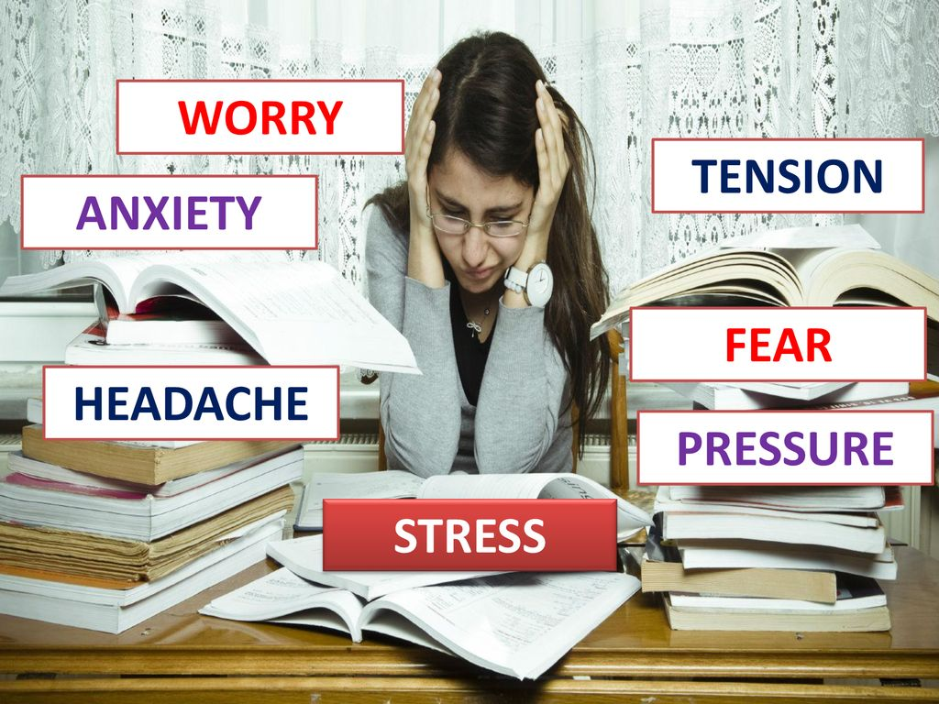
Normal!
Notes:
https://www.gov.uk/government/consultations/proposed-changes-to-the-assessment-of-gcses-as-and-a-levels-in-2022/outcome/decisions-proposed-changes-to-the-assessment-of-gcses-as-and-a-levels-in-2022
https://www.edgehill.ac.uk/news/story/reducing-debilitating-test-anxiety/

Slide 3




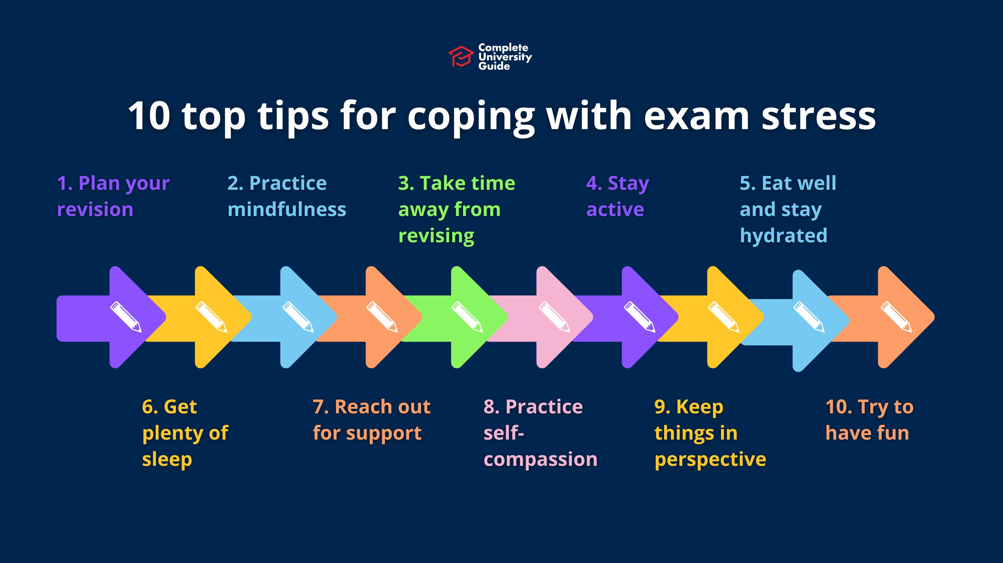
Coping with exam stress

Slide 4

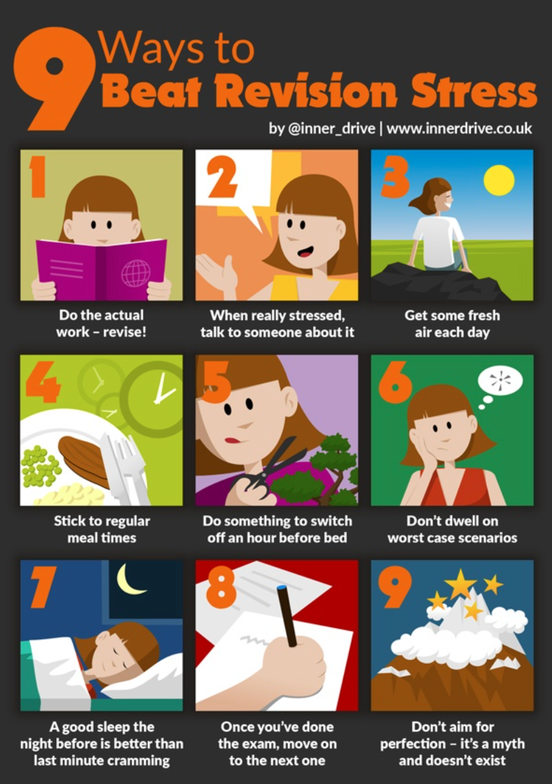
How to deal with exam stress
Professor Dave Putwain - ​
https://www.edgehill.ac.uk/news/story/reducing-debilitating-test-anxiety/
Don’t rely on a single strategy to revise
Make a revision timetable and stick to it
It isn’t a solo journey – collaborate!
Practice makes perfect – past exam papers/mocks
Take a deep breath and give yourself time to think

Slide 5
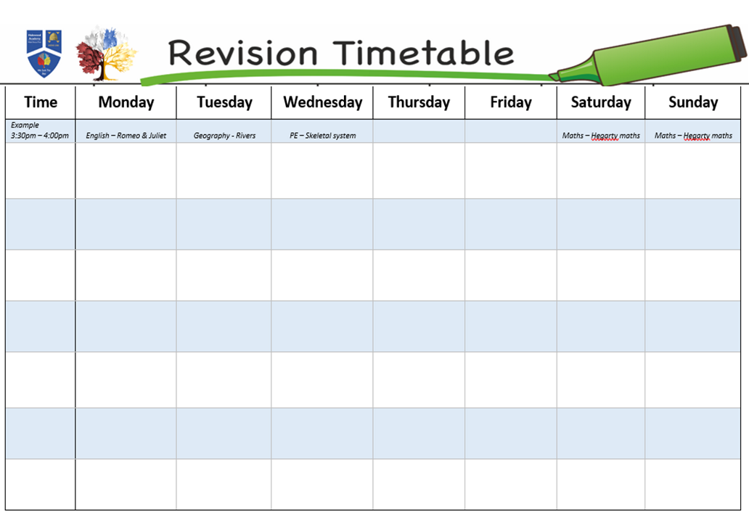
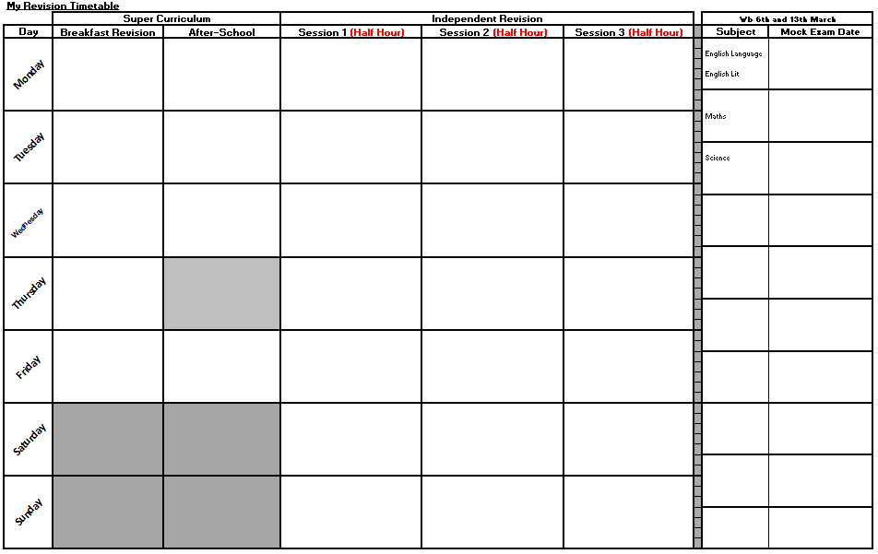
How to get started...
Be Realistic!
Use your time wisely
It is a guide!

Slide 6
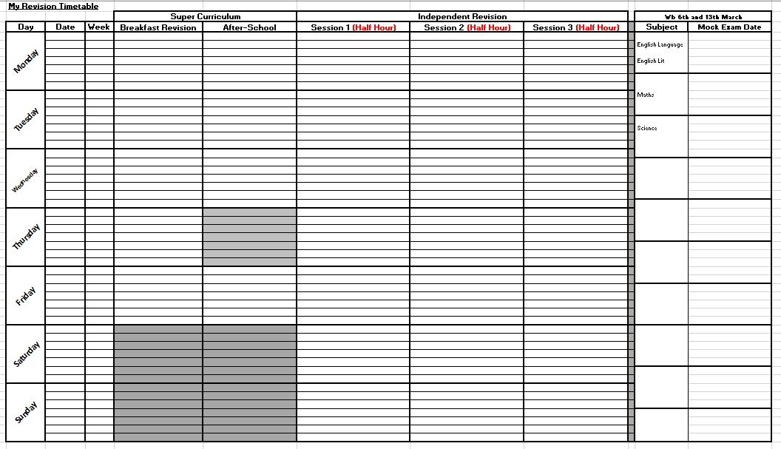
Super Curriculum - There are plenty of revision sessions set by your teachers.
Plan what independent revision sessions you will do– be specific!
Find out when your mock exams are to prioritise and plan revision.

Slide 7
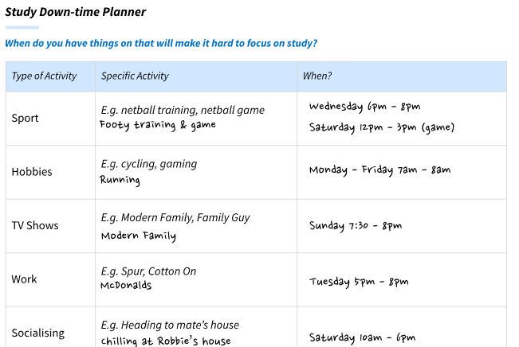
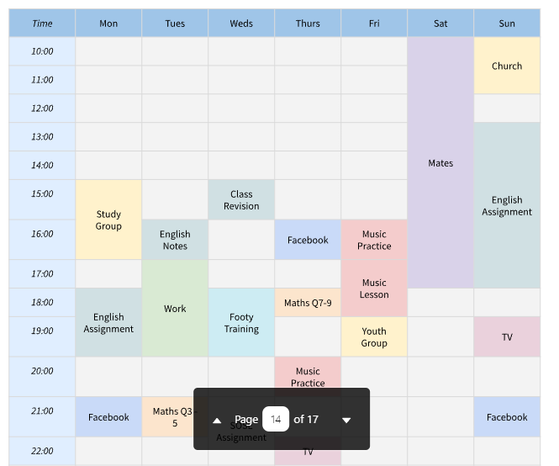

Slide 8
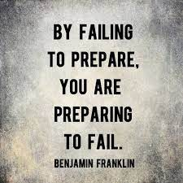
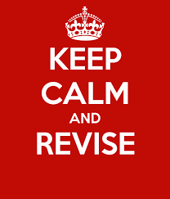
Top Tips...
Plan - Use your timetable – display this in your bedroom/fridge/phone.
Collaborate – Work with others, set group revision and solo sessions. Many hands make light work!
Organise your revision – Sort your revision into neat and tidy piles or files so it is easy to use/find. DISPLAY revision around your room. PLAN your revision (checklists).
Find somewhere quiet – revise somewhere quiet and with little distractions. Work at your alert times of the day.
Reflect – look at errors you made in your mocks and focus on those areas of weakness first.
Take breaks – don't spent hours revising something, try to chunk your revision. Use breaks to get fresh air, changes of scenery.

Slide 9
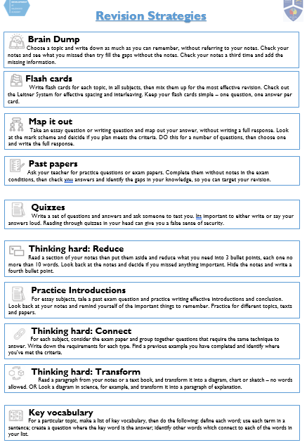
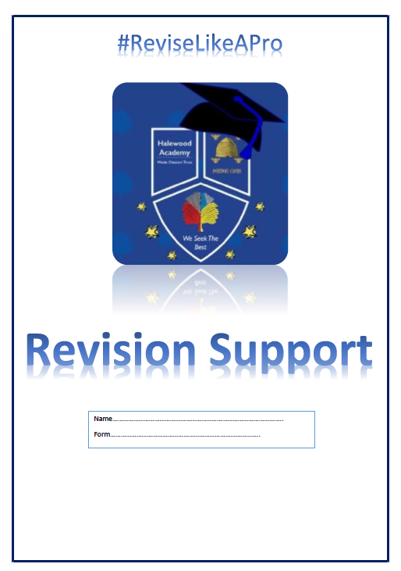
Revision Strategies
In your booklet

Slide 10
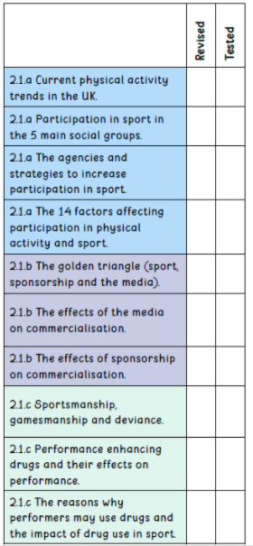
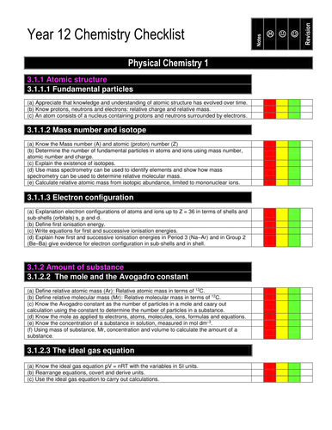
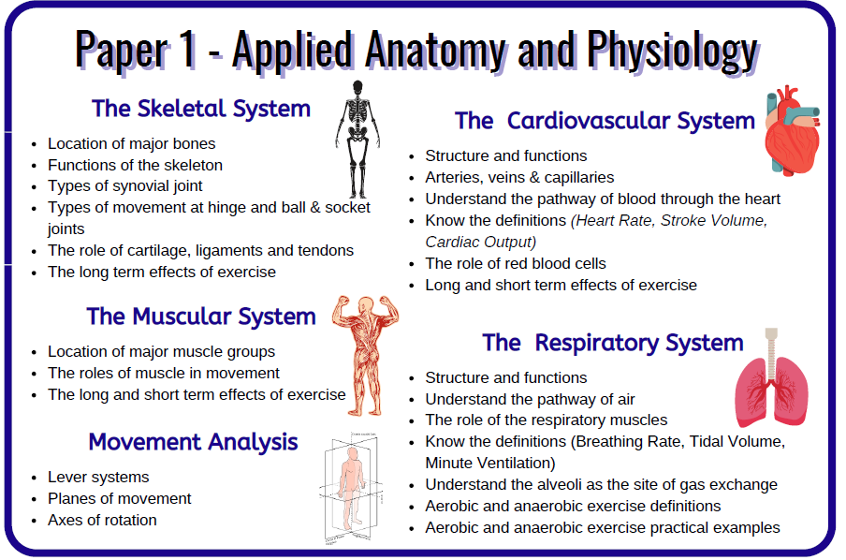
Prioritise and Plan
Studies show students (often girls) seem to think they're revising; however they are sometimes revising the same topic areas over again due to already understanding that topic. This is often due to a need to avoid failure, therefore when they are revising a topic they know it is easier and they're less likely to make mistakes. Sometimes students may need more guidance.
To avoid this:
Revision timetables – detailed by paper/topic area using specification
Knowledge organisers
RAG rating information or checklist
Give students a copy of the specification (make it child friendly)
Post exam self-assessment of weaknesses
Find out the dates and times of mock exams
to allow you to organise your time
Name: Exam score:
Priorities:

Slide 11
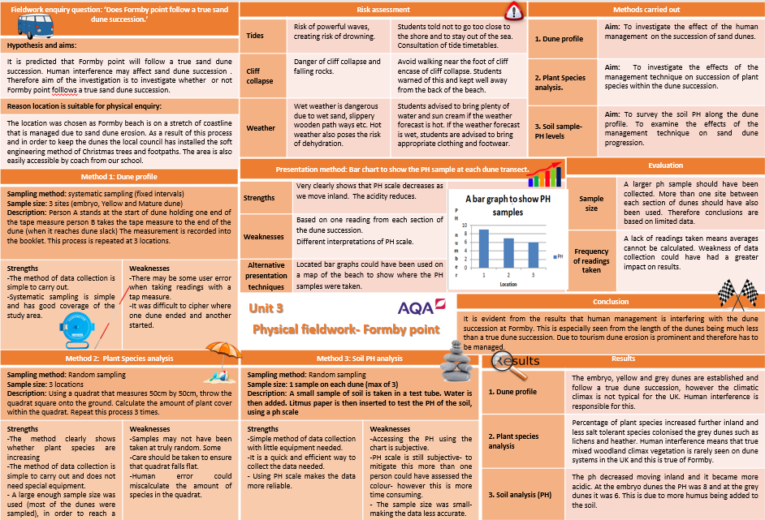
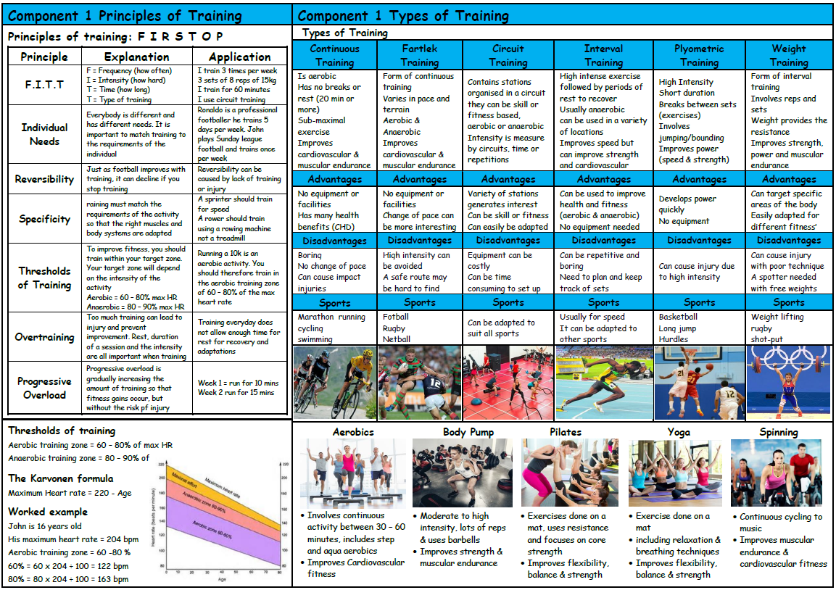
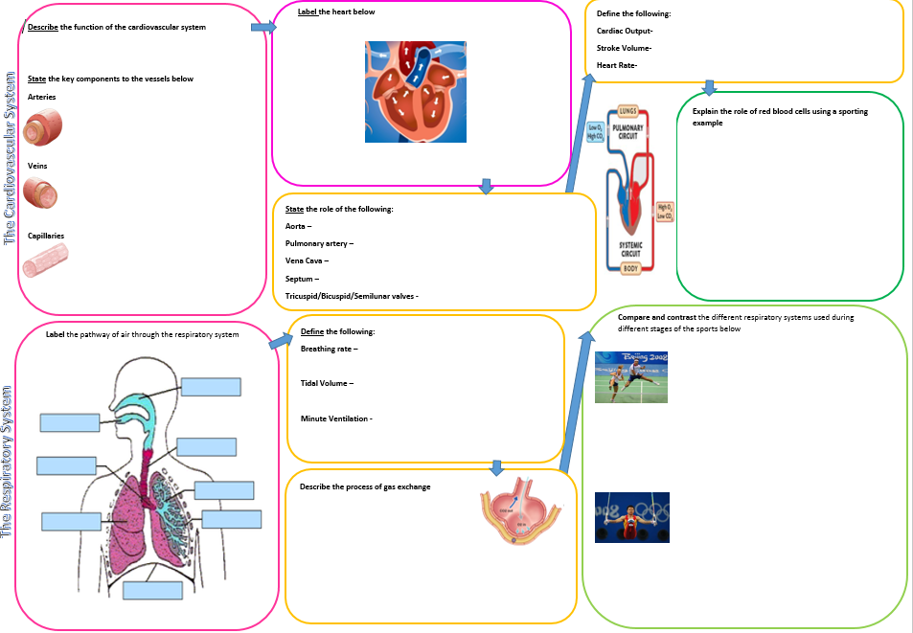
Knowledge Organisers
A knowledge organiser is a document, usually no more than two sides of A4, that contains key facts and information that children need to have a basic knowledge and understanding of a topic.
Most knowledge organisers will include: the essential facts about the topic, usually laid out in easily digestible chunks.
Create your own as a revision task

Slide 12
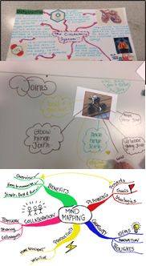
Mind Maps
Mind Maps help to simplify complex ideas, make connections to see the “bigger picture” and allow you to be creative so you don’t get bored.
How To:​
Use a landscape sheet of A4 or A3 paper.​
Put the topic in the centre.​
Main Branches: Your branches should have one word or two for clarity. Think of each branch as a heading in an essay or a book.​
Sub-branches: From your main branches draw sub-branches and from those sub-branches you can draw more branches. Here you can create associations between ideas.
Top Tips:
Use COLOUR to make it visually interesting. Use a different colour for different branches to link the learning together.
Draw pictures. They don’t need to be a work of art, but they will help you to remember it.
Make sure each branch is curved and not straight. The brain is more stimulated by curved lines.

Slide 13
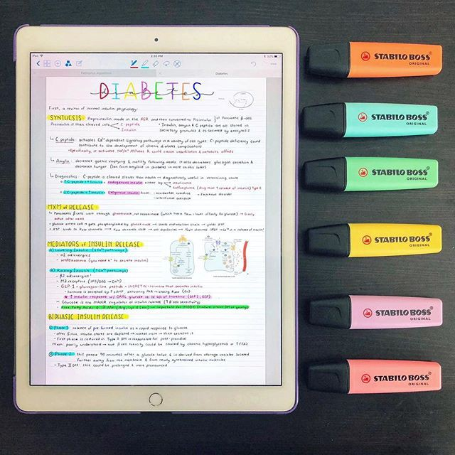
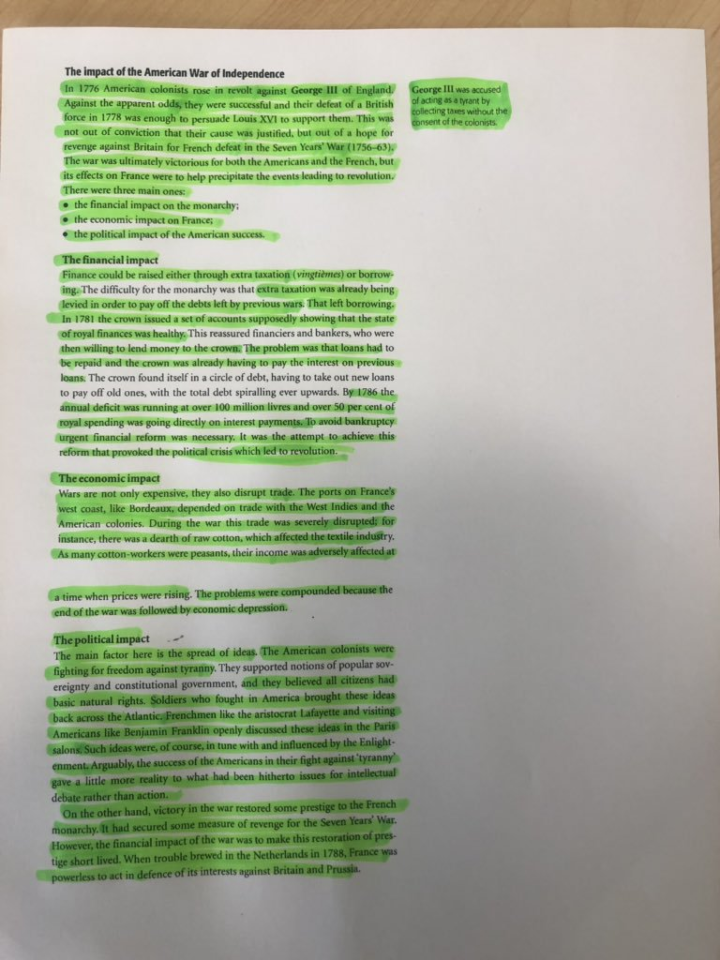


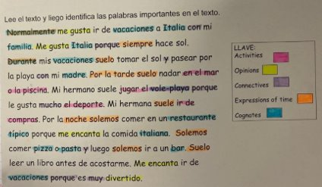
Summarising/Highlighting Information
By highlighting key points in the material, you will have visual clues guiding your revision come exam time.
Yellow → Highlight in yellow important points, facts, examples etc.
Pink → Use pink (or orange) to denote material that is even more important than what’s in yellow.
Blue → Reserve blue for words that will subsequently be defined (and then put their definitions in pink), titles or special terms.
Green → Mark in green dates, names or places that you will need to remember. Green can also be used for formulas.
Purple → If the material contains any rules, use the boldness of purple to set them apart.

Slide 14
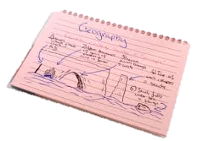
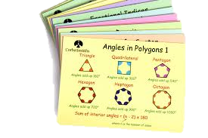

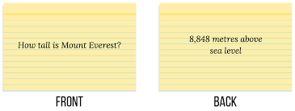
Flash Cards
Top Tips!
Use for testing and not summarising information
One idea, one card
Use both texts and pictures (65% more info remembered when visual)
Spaced repetition to memorise
Don’t just use flash cards!
Useful websites
Quizlet: Create your own flashcards or use sets made by others for vocabulary and key terms.
Anki: Powerful flashcard system using spaced repetition for effective memory recall.
Get Revising: Study planner, timetables, and flashcards

Slide 15
Useful websites
Core subjects and all round –
BBC Bitesize: Comprehensive, topic-based revision with videos, quizzes, and study guides for all subjects, tailored to exam boards.
Seneca Learning: Free, interactive courses with videos and quizzes that help you learn faster.
Save My Exams: Detailed notes, practice papers, and model answers, especially strong for Sciences and Maths.
Revision World: Offers notes, past papers, and resources across many GCSE and A-Level subjects.
Maths Genie: Excellent for GCSE Maths with practice questions and videos.
Corbettmaths: Great for Maths, with videos, worksheets, and daily practice.
Physics & Maths Tutor (PMT): Extensive collection of past papers, topic questions, and resources for sciences and maths.
Cognito: Free resources for GCSE Maths and Sciences, featuring videos, questions, and quizzes

Slide 16



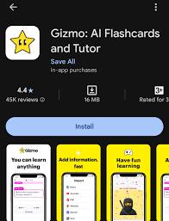



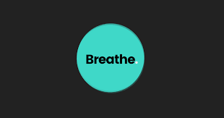
Useful apps

Slide 17


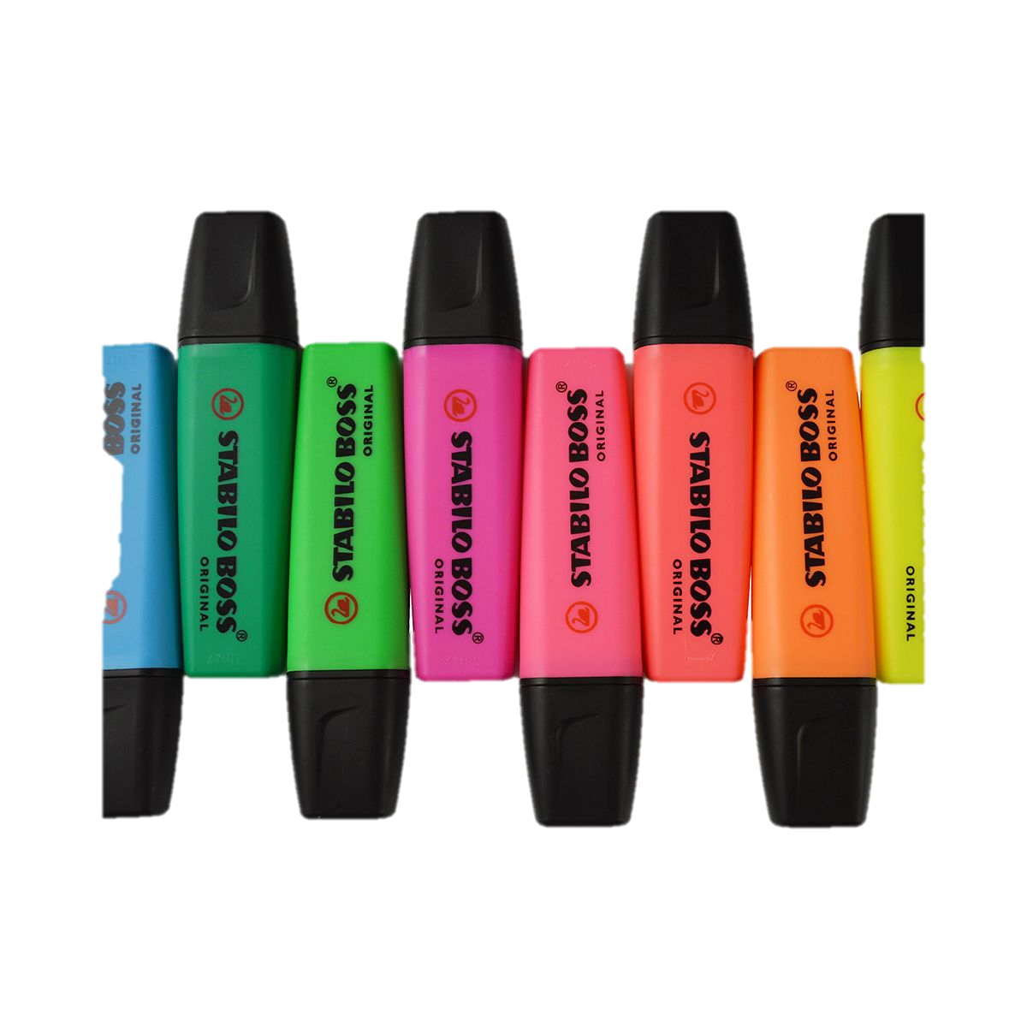
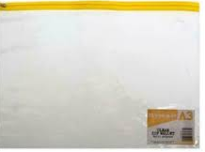
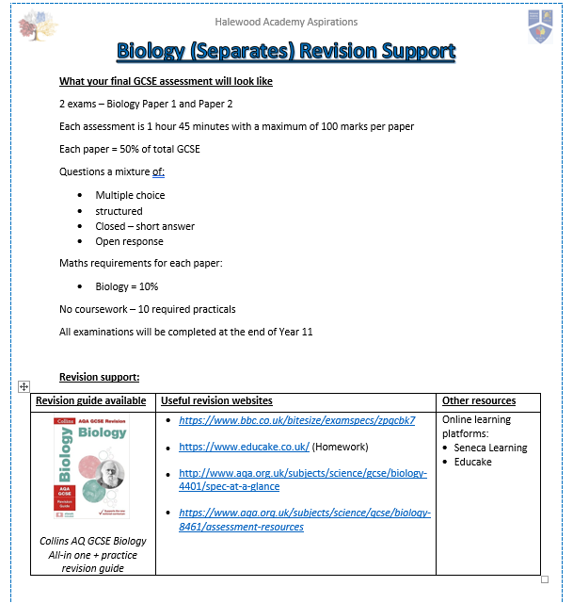
See Mrs Jones for Revision Resources

Slide 18

Thank you for listening!

