Slide 1
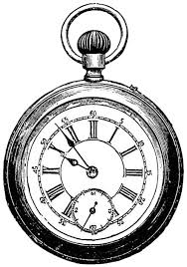
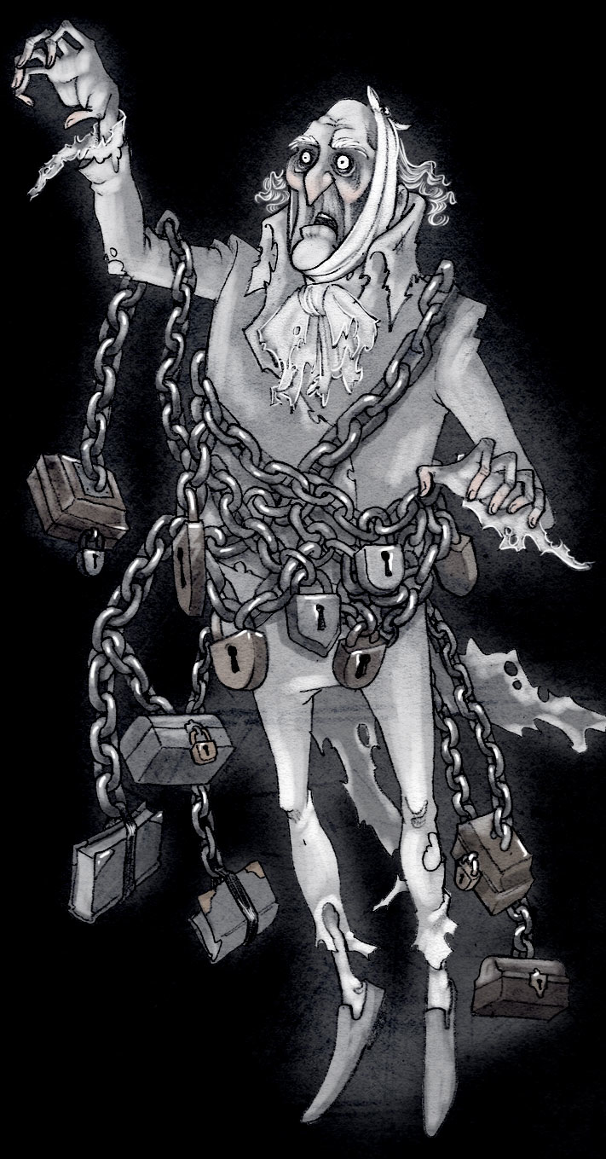
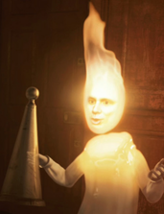
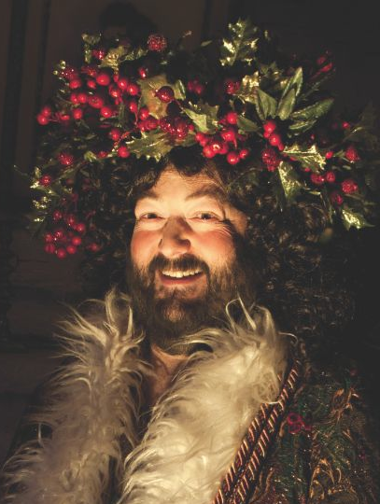
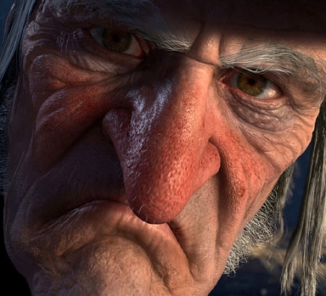
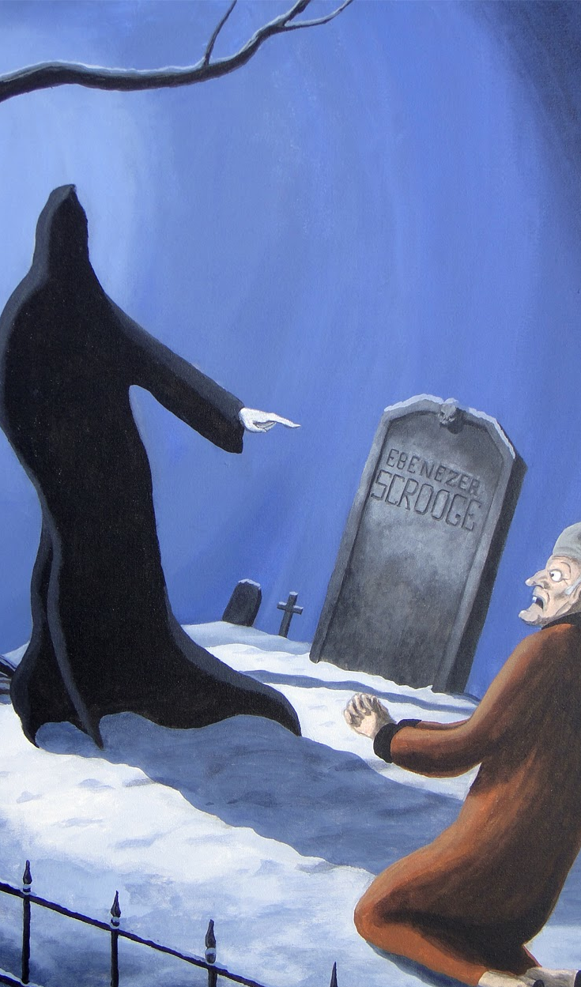
Scrooge is in his counting-house on Christmas Eve
The chain-wearing ghost of Jacob Marley visits to warn Scrooge that he will be visited by three spirits.
The Ghost of Christmas Past takes him to his old schoolhouse.
A Christmas Carol – Knowledge Organiser
The tone of the novella shifts with the arrival of the deathly Ghost of Christmas Yet to Come, who shows Scrooge a dark future where he has died a lonely man.
Scrooge wakes on Christmas morning and is enlightened and transformed.
We see Scrooge’s fiancée, Belle, leaving him
3
They visit nephew Fred’s house
4
5
1
Scrooge is rude to Fred, refuses the charity collectors and reluctantly allows his clerk to take Christmas Day off.
2
They visit young Scrooge at a Christmas party thrown by Mr Fezziwig.
Scrooge cannot bear anymore and trues to extinguishes the ghost’s light
The Ghost of Christmas Present takes him to Bob Cratchit’s home to show how the poor can still be happy.
Scrooge spots two impoverished children under the ghost’s cloak.
Scrooge sees his name on a grave and begs for salvation. The ghost relents and saves him.
Scrooge is forgiven: he goes for dinner at Fred’s house. He is the saviour of himself and also of Tiny Tim (who now lives).
Stave | Key Quotation | Info / Analysis
Stave One Marley’s Ghost | Hard and sharp as flint | Description of Scrooge at start
 | solitary as an oyster | Simile to convey his lone existence
 | “I don’t make myself merry at Christmas, and I can’t afford to make idle people merry.” | Shows his unsympathetic attitude to the poor (‘idle’) people.
 | “It’s enough for a man to mind his own business, and not to interfere with other people’s.” | He is obsessed with business and money.
 | “I wear the chain I forged in life” Jacob Marley | A warning for Scrooge: Marley created his own eternal punishment through his greed.
 | “There is no light part of my penance” Jacob Marley | Penance = punishment
Stave Two Ghost of Christmas Past | From the crown of its head there sprung a bright clear jet of light | Refers to Ghost of Christmas Past. The light represents truth and enlightenment
 | “Your reclamation, then. Take heed!” Ghost of Xmas Past | Reclamation = recovery / change Take heed = listen and learn
 | “Your lip is trembling,” said the Ghost. “And what is that upon your cheek?” | Scrooge visits his old schoolhouse and first shows emotion (self-pity).
 | A solitary child, neglected by his friends, is left there still | Description of Scrooge as a child. How has his childhood affected him?
 | “He has the power to render us happy or unhappy […] The happiness he gives is quite as much as if it cost a fortune.” | Scrooge speaking of Fezziwig’s generosity. He realises how an employer can affect his employees.
 | “I have seen your nobler aspirations fall off one by one, until the master passion, Gain, engrosses you.” | Scrooge’s ex-fiancée (Belle) when she leaves him, because he is obsessed with ‘Gain’.
 | “Remove me!” Scrooge exclaimed. “I cannot bear it!” | Scrooge, just before extinguishing the ghost’s light (he can’t bear the truth).
Stave Three Ghost of Christmas Present | Scrooge entered timidly, and hung his head before this Spirit | Scrooge is more subdued when he meets the second ghost (Ghost of Xmas Present).
 | “Oh no, kind Spirit! Say he will be spared” | Scrooge shows concern and sympathy for Tiny Tim.
 | “To hear the insect on the leaf pronouncing on the too much life amongst his hungry brother in the dust!” | The Ghost reminds Scrooge of his earlier words about decreasing the population of the poor. He compares Scrooge to an insect.
 | “I am sorry for him […] Who suffers by his ill whims? Himself, always.” | Fred discusses his Uncle Scrooge with the family.
 | Uncle Scrooge had imperceptibly become so gay and light of heart | Scrooge is delighted that his family even speak of him.
 | “This boy is Ignorance. This girl is Want. Beware them both.” | The ghost warns Scrooge with personification / symbols of mankind’s faults.
Stave Four Ghost of Christmas Yet To Come | plundered and bereft, unwatched, unwept, uncared for, was the body of this man | Description of the man on the deathbed.
 | Avarice, hard dealing, griping cares? They have brought him to a rich end, truly! | Scrooge’s ironic statement about the dead man, before he realises that he is looking at himself.
 | “Are these the shadows of the things that Will be, or are they the shadows of the things that May be only?” | Scrooge asks the ghost if it too late for him to transform and alter his future.
 | “Men’s courses will foreshadow certain ends” | Scrooge realises that his past behaviour will determine his future
Stave Five | “I don’t know how long I have been among the Spirits. I don’t know anything. I’m quite a baby.” | Scrooge discards logic and is now carefree. He is a transformed character.
 | Scrooge regarded everyone with a delighted smile. | He spreads good-will instead of fear and hatred.
Themes
Logic and Time Scrooge’s sense of logic is continually disrupted, helping to dismantle his cold and rational view of society. He initially dismisses the supernatural appearances, before then submitting to them. The ghosts are late to visit him, and then distort time as they seem to visit him all in one night – not over three nights as planned. This discarding of logic reflects Dickens’ criticism of the heartless economical logic that was used to create the New Poor Law.
Compassion, Forgiveness and Reclamation Dickens uses different characters to demonstrate compassion and forgiveness (Fred and Bob who feel pity for him) and how these people lead happy lives. In contrast, he shows the selfish nature of mankind in the dark and sinister Stave Four. Fred shows compassion and forgiveness to Scrooge in Stave Five by welcoming him for Christmas.
Poverty and Greed Dickens wanted to highlight the plight of the poor in Victorian England, and how they are exploited by the greed of the wealthy. He used to harshness of winter to further emphasise this. He also uses Scrooge as a vehicle to show that financial wealth does mean contentment. Scrooge is impoverished in other ways (family, friends, happiness).
Isolation versus Family We quickly learn that Scrooge (‘solitary as an oyster’) and Marley are isolated, and unhappy, characters. Scrooge was Marley’s ‘sole friend and sole mourner’. The warmth and emotional richness of families (Bob Cratchit’s, Fred’s, his ex-fiancée’s) are used as a contrast to Scrooge’s self-determined isolation. The disruption to Scrooge’s childhood family life may have also contributed to his future behaviour. The message may be that family is the cornerstone of a happy society.
Transformation The novella contains many examples of transformation: the transformation of young Scrooge into an embittered old man; his transformation to a benevolent man; the transformation of Marley from selfish human to eternally-suffering ghost; supernatural transformations; the transformation of the future – to save Scrooge and Tiny Tim. Dickens message may have been that it is never too late to change.
Key Characters
Scrooge The protagonist who initially dismisses the goodwill and generosity associated with Christmas. After being forced to transform, he becomes a symbol of Christmas spirit in Stave Five. He is cheerful and benevolent. He is a dynamic character (a character who changes).
Bob Cratchit and family Bob is Scrooge’s downtrodden but loyal employee. His family are a symbol of Victorian poverty, cheerfulness in adversity, teamwork and Christmas Spirit. Bob shows pity for Scrooge, and provides a contrast to Scrooge’s isolation and meanness.
Nephew Fred The character of Fred serves as another contrast to Scrooge. He epitomises the Christmas spirit of goodwill and refuses to be discouraged by his uncle’s misery. People (such as the Cratchits) speak highly of him and his generosity, in contrast to how they speak of Scrooge. Fred shows that Scrooge has chosen isolation.
The Ghosts The ghosts are the antagonists to Scrooge. They force him to view his selfish and greedy ways, and to admit how his behaviour will lead to a lonely death (“Men’s courses will foreshadow certain ends”): a metaphor for how the greed of the wealthy middle class will lead to a disastrous future for society.
Context
Dickens’ message on poverty Dickens had a comfortable childhood until the age of 12 when his father was sent to a debtors’ prison and young Charles had to work in a factory. The harsh conditions made a lasting impression: through his works of social criticism, he sought to draw attention to the plight of the poor.
The New Poor Law, 1834 In order to deter poor people from claiming financial help, the government made claimants live in workhouses: essentially, prisons for the poor. Dickens hated this concept. He spent 1843 touring factories and mines in England and wished to highlight the situation facing poor people. A Christmas Carol was published soon after – in December 1843.
The ingredients for a hit novella Dickens previous novel had not sold well and so he needed a hit. He deliberately combined elements that he knew would appeal to Victorian readers: a parable; the supernatural; a happy conclusion; and Christmas.
Dickens’ construction of secular Christmas values Until the mid-1800s, Christmas was solely a religious festival. Dickens helped to popularise many of the cultural elements that we now associate with Christmas. This imagery (the food, the decorations, the music) is used throughout the novella. This has contributed to a more secular (non-religious) Christmas, based on good-will, benevolence and forgiveness.
Form and Structure
The novella is narrated in the third person by an omniscient narrator, who also seems very biased against Scrooge. It is a parable: a moral tale with a strong message. It is arranged in five staves (not chapters) as a metaphor for an actual Christmas carol. It contains much musical imagery throughout (church bells, clock chimes, carol singers, Fezziwig’s party). Dickens uses a circular structure. Scrooge’s interactions in Stave Five mirror those in Stave One, however he now treats everyone much differently (Fred, Bob Cratchit, the portly gentlemen, the young boy, Christmas itself). The weather also changes to reflect his transformation.

