Slide 1
English Department Exam Information 2019 – 2020
Halewood Academy

Slide 2
English Language Information

Slide 3
English Language Course 2019- 2020
English Language Paper 1 – Fiction Paper – 1 hour 45 minutes
2 sections – Section A is the reading section
Section B is the writing section
Section A (40 marks) 1 hour
Reading questions will be asked – 5 of them. The extract will be taken from a 20th century text.
Section B (40 marks) 45 mins
Writing questions – choice of tasks – only one
needs to be completed.

Slide 4
Paper 1 Detail – Reading Section
1 hour
Question 1 (line numbers given)
List 5 things you learn... (5 marks) SKILL = RETRIEVAL
Question 2 (line numbers given)
How does the writer show (5 marks) SKILL = LANGUAGE ANALYSIS EFFECT
Question 3 (line numbers given)
What impression do you get (10 marks) SKILL = LANGUAGE ANALYSIS – HOW DOES IT MAKE THE READER FEEL?
Question 4 (line numbers given)
How does the writer make these lines (vivid...interesting...mysterious). (10 marks) SKILL = LANGUAGE AND STRUCTURE ANALYSIS
Question 5 (line numbers given)
To what extent do you agree? SKILL = COMPREHENSION QUESTION PLUS LANGUAGE AND STRUCTURE ANALYSIS

Slide 5
Paper 1 – Writing Section – 45 mins
You will be give 4 options to write a creative response to.
Some prompts might be:
The Journey.
The Misty Morning
Write about a time when you went for a walk.
Write a story which begins:
After all these years, who would have thought that...
40 marks awarded for this response. 24 marks for content and 16 marks for SPAG.

Slide 6
English Language Paper 2 – Non Fiction Paper – 2 hours
2 sections – Section A is the reading section
Section B is the writing section
Section A (40 marks) 1 hour
Reading questions will be asked – 6 of them. There are two extracts, one from the 19th and one from the 21st century.
Section B (40 marks) 1 hour
There are two writing questions – you must answer both of them. Spend 30 mins on each question. The questions will require you to write a letter, an article, a report –
basically you must give your own perspective on topics given to you.

Slide 7
Paper 2 Detail – Reading Section – 1 hour
Question 1 – FIRST TEXT
Answer 3 short questions from the first text. (3 marks) SKILL = RETRIEVAL
Question 2 – FIRST TEXT
How does the writer achieve their purpose (10 marks) SKILL = ANALYSE LANGUAGE, TONE AND STRUCTURE
Question 3 – SECOND TEXT
Answer 3 short questions from the second text. (3 marks) SKILL = RETRIEVAL
Question 4 – SECOND TEXT
What do you think and feel about... (10 marks) SKILL = EXPLAIN, ANALYSE LANGUAGE AND STRUCTURE
Question 5 – BOTH TEXTS
Summary question (4 marks) SKILL = SUMMARISE POINTS – GIVE AN OVERVIEW
Question 6 – BOTH TEXTS
Comparison question (10 marks) SKILL = COMPARE SIMILARITIES AND DIFFERENCES BETWEEN THE TEXTS, ANALYSE LANGUAGE

Slide 8
Paper 2 – Writing Section – 40 marks – two questions
Each question is worth 20 marks
First Writing Question
This question asks you to advise and inform the reader.
Content = 12 marks
SPAG = 8 marks
Second Writing Question
This question asks for you to give your own perspective and opinion about a particular topic.
Content = 12 marks
SPAG = 8 marks

Slide 9
English Literature Information

Slide 10
English Literature Paper 1
2 hours
80 marks and 40% of the English Literature GCSE
Section A – 1 hour
Two questions about a Shakespeare play – Romeo and Juliet
Question 1 – analyse the extract – how would an audience react? (15 marks)
Question 2 – analyse the theme (20 marks +5 for SPAG)
Section B – 1 hour
Two questions about the poems from the Anthology
Question 1 – Explore the poem printed on the page (15 marks)
Question 2 – Compare the printed poem to another poem of your choice (25 marks)

Slide 11
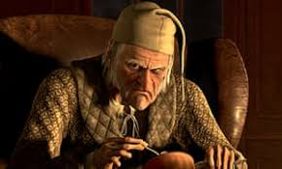
English Literature Paper 2
2 hours 30 mins
120 marks and 60% of the GCSE
Section A (35 marks + 5 SPAG)
Blood Brothers – Read the extract and answer the question – also analyse the rest of the play. 45 mins.
Section B (40 marks)
A Christmas Carol – Read the extract and answer the question – also analyse the rest of the play. 45 mins.
Section C
Unseen Poetry – answer two questions – analyse and compare. 1 hour.
Question 1 - Analyse the first poem printed on the page (15 marks)
Question 2 – Compare the first poem to the second poem (25 marks)

Slide 12
Revision Information English Department

Slide 13
Revision for English
There will be opportunities for students to attend specific and targeted revision sessions. There is also an opportunity for students to revise with their class teacher each week on Tuesdays after school. However, students should be revising at home as much as possible for English.
Revising in short sessions works best. So, in one session the student might decide to look at English Language, Paper 1, question 3 or they might want to analyse the character of Mrs Johnstone in ‘Blood Brothers’, picking out key quotes or creating a poster with all the information they can find about her.
It would also be useful for students to have a copy of ‘Romeo and Juliet’ (William Shakespeare), ‘A Christmas Carol’ (Charles Dickens) and ‘Blood Brothers’ (Willy Russell) at home to read and annotate. Students could use highlighters for key quotes or write in the book to identify themes or important ideas in the books.

Slide 14
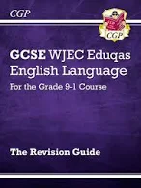
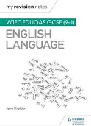
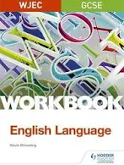
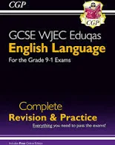
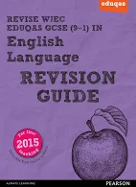
Revision Books for English Language

Slide 15
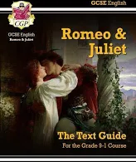
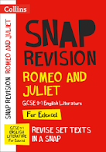
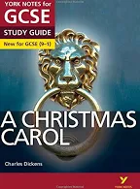
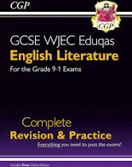
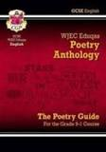
Revision Books for English Literature
There are many more books on the market that you can buy to support English revision. Eduqas are the exam board we use at Halewood Academy but York Notes (amongst others) have guidance that can be used for revision purposes with any exam board.

Slide 16
Ways to revise for English Language and Literature
Past Papers are available online and will be made available in the English homebase.
Annotate clean copies of poems (available on the Internet or from Homebase 3).
Annotate own copies of books at home from memory, using the Internet to research missing information/ideas.
Use post-it notes for key ideas/quotes.
Create tables to compare poems in terms of language, structure and content.
Create mind maps for poetry analysis or key characters in plays/novels.
Use flashcards to revise key information from poems or novels.
Listen to audio versions of the Literature books.
Use the revision books recommended to support learning.

Slide 17
Example of a Literature Revision Timetable
WB: 9/01/19 | Mon Romeo and Juliet – character study. | Tues | Weds BB Mrs Lyons & Mrs Johnstone | Thurs | Fri | Sat | Sun Unseen poem
WB: 16/01/19 | Mon | Tues BB Gender Issues | Weds | Thurs Romeo and Juliet – themes. | Fri | Sat | Sun 2 x Anthology poems
WB: 23/01/19 | Mon BB Mickey & Edward | Tues | Weds Unseen poetry - compare | Thurs | Fri A Christmas Carol Religion/ redemption | Sat | Sun
WB: 30/01/19 | Mon 2 x Anthology poems | Tues | Weds | Thurs Romeo and Juliet – key scene | Fri | Sat | Sun A Christmas Carol The Cratchits
WB: 6/02/19 | Mon | Tues BB Fate/ superstition | Weds | Thurs Romeo and Juliet –The Prologue | Fri | Sat | Sun 2 x Anthology poems

Slide 20
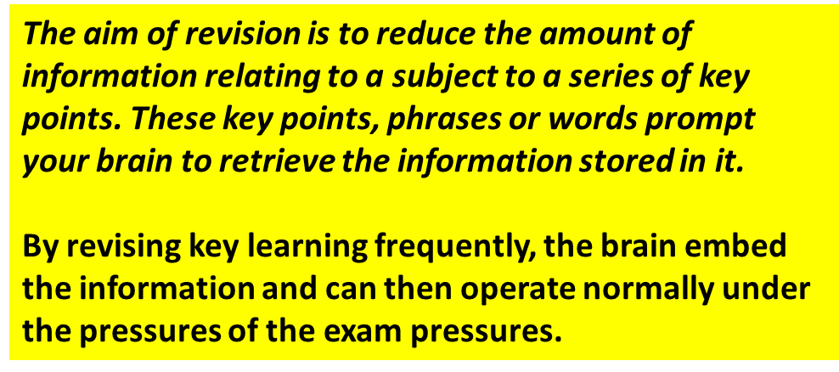

Slide 21
Parents are Important

Slide 24
Top Tips

Slide 25
Top Tips

