Slide 1
EDUQAS POETRY ANTHOLOGY
SUMMARY SHEETS

Slide 2
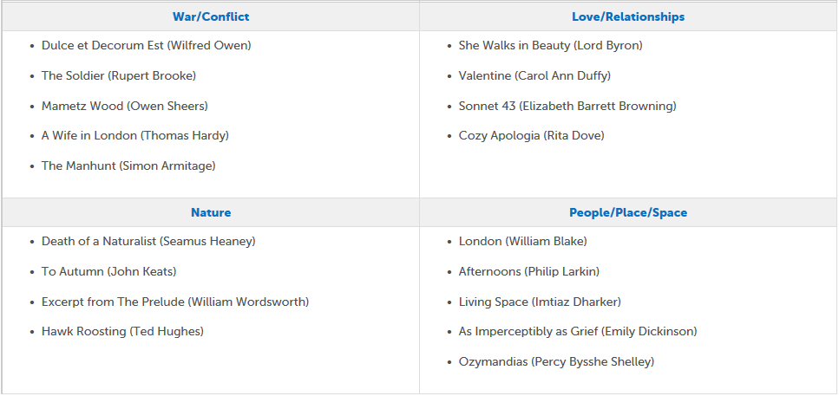
Eduqas Poetry Anthology: Themes

Slide 3
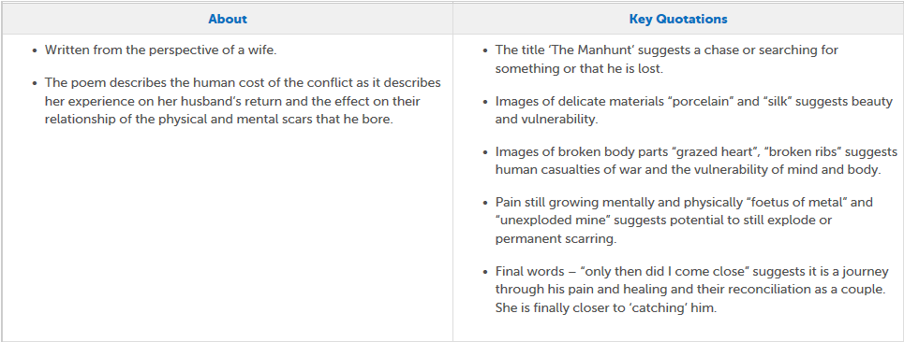
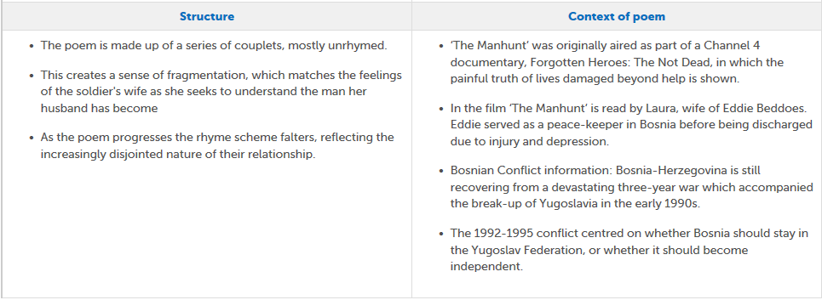
Eduqas Poetry Anthology: The Manhunt

Slide 4
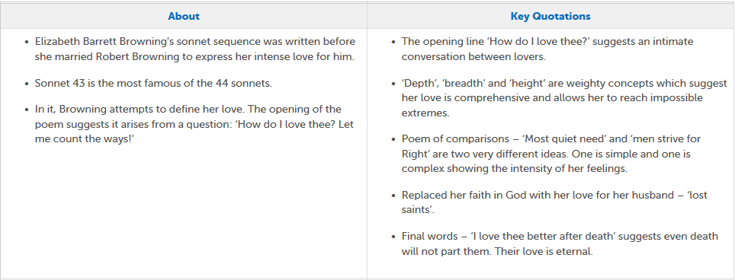
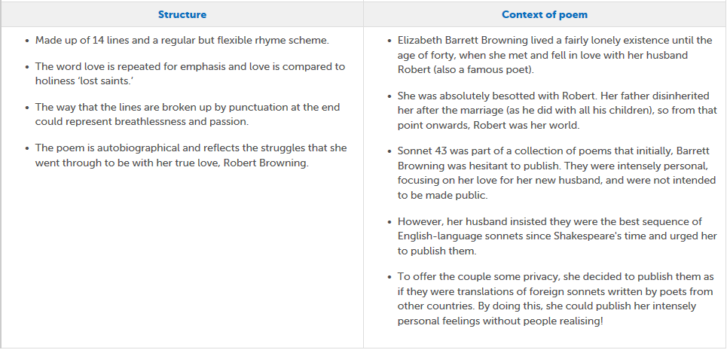
Eduqas Poetry Anthology: Sonnet 43

Slide 5
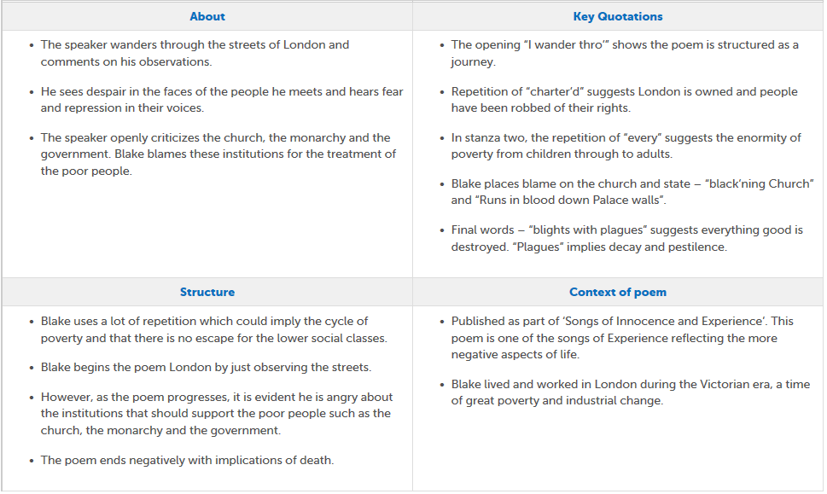
Eduqas Poetry Anthology: London

Slide 6
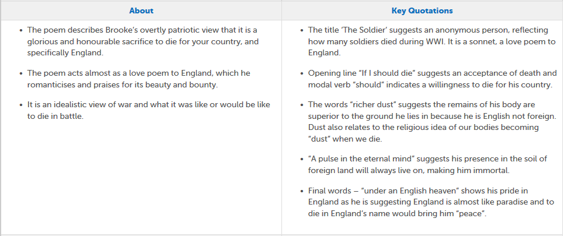
Eduqas Poetry Anthology: The Soldier

Slide 7
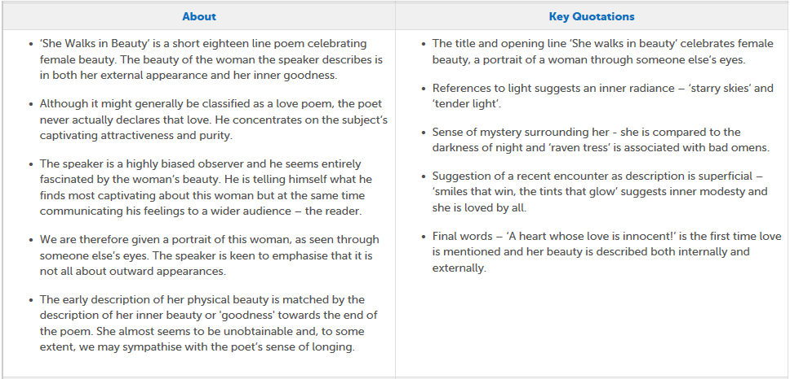
Eduqas Poetry Anthology: She Walks in Beauty

Slide 8
Eduqas Poetry Anthology: Living Space

Slide 9
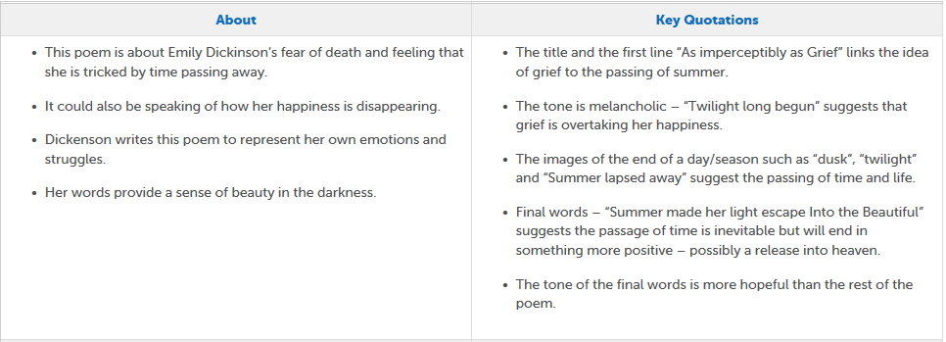
Eduqas Poetry Anthology: As Imperceptibly as Grief

Slide 10
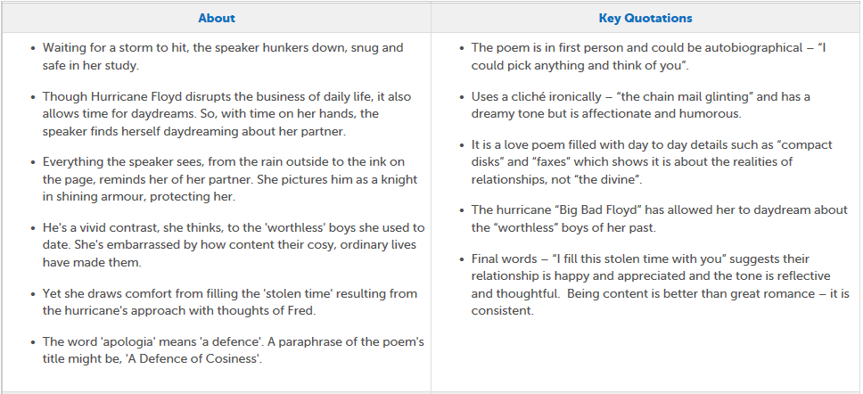
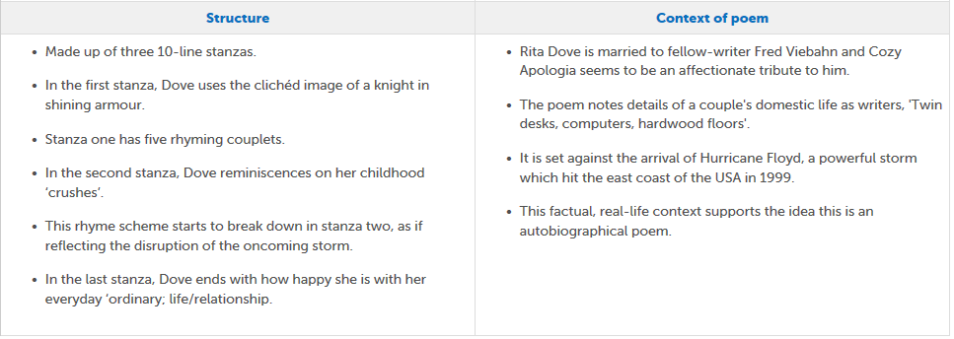
Eduqas Poetry Anthology: Cosy Apologia

Slide 11
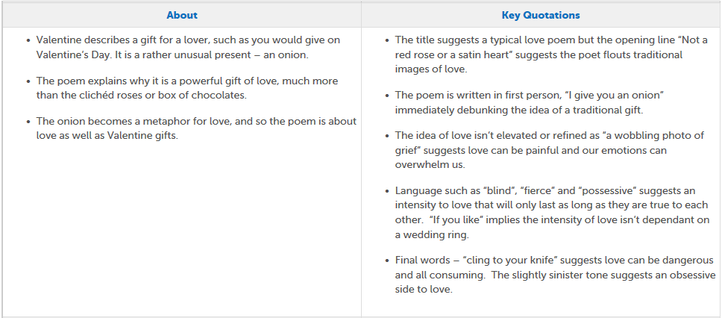
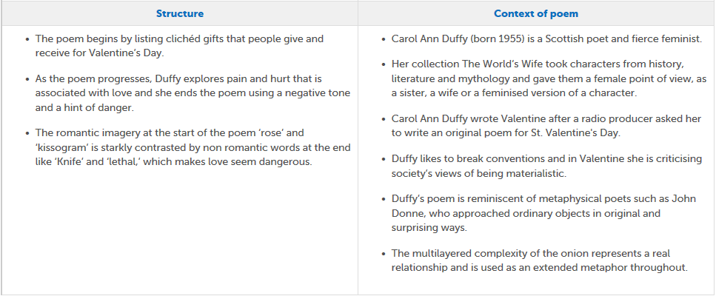
Eduqas Poetry Anthology: Valentine

Slide 12
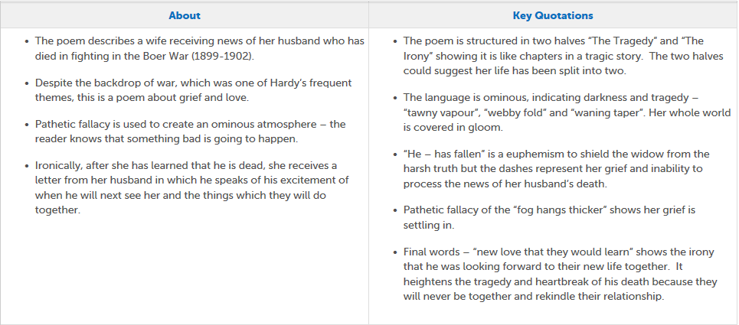
Eduqas Poetry Anthology: A Wife in London

Slide 13
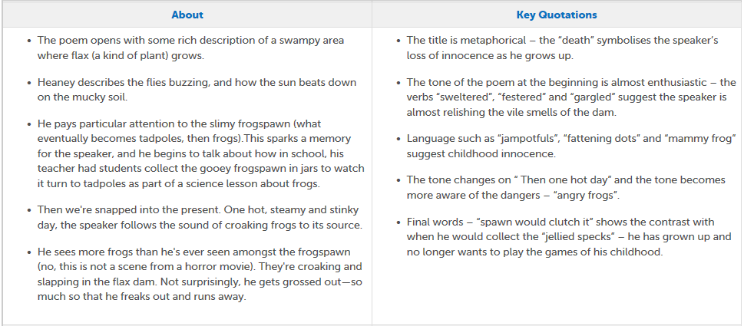
Eduqas Poetry Anthology: Death of a Naturalist

Slide 14
Eduqas Poetry Anthology: Hawk Roosting

Slide 15
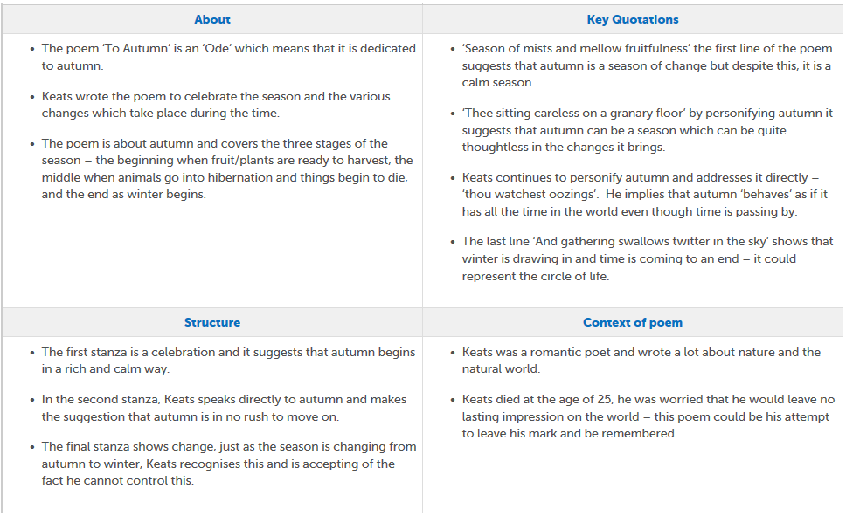
Eduqas Poetry Anthology: To Autumn

Slide 16
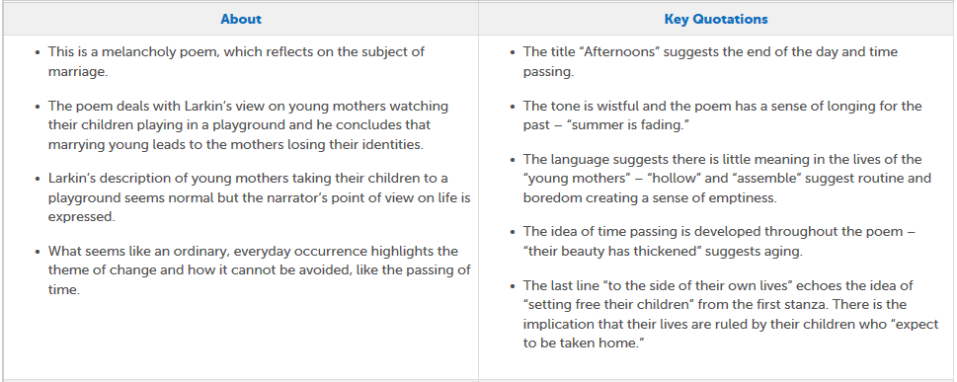
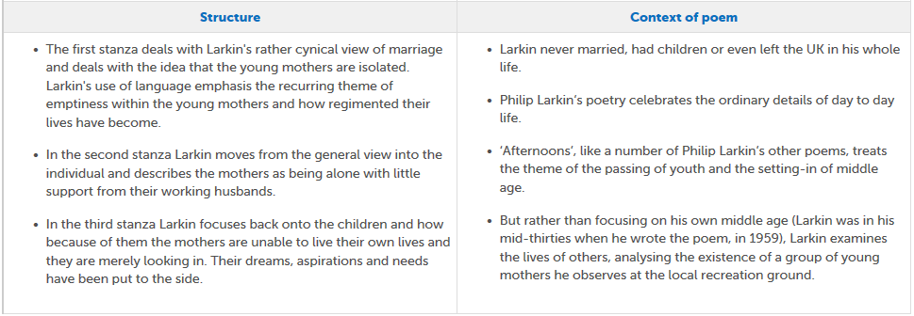
Eduqas Poetry Anthology: Afternoons

Slide 17
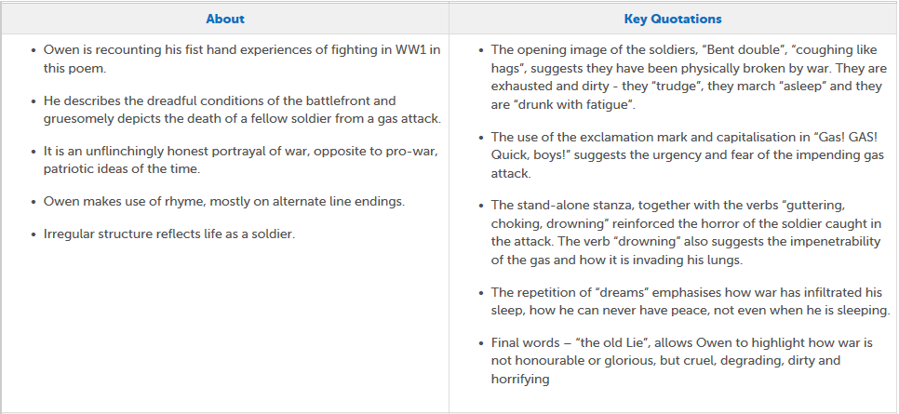
Eduqas Poetry Anthology: Dulce et Decorum Est

Slide 18
Eduqas Poetry Anthology: Ozymandias

Slide 19
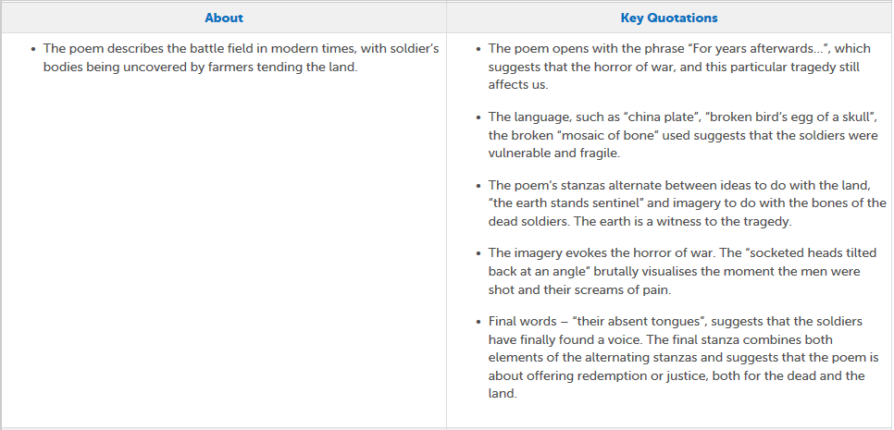
Eduqas Poetry Anthology: Mametz Wood

Slide 20
Eduqas Poetry Anthology: Excerpt from The Prelude

