Slide 1
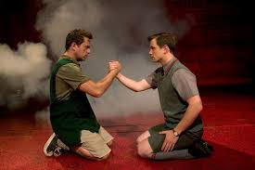
Who Said it?
Blood Brothers

Slide 2
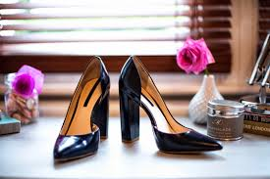
‘You never put new shoes on the table’

Slide 3
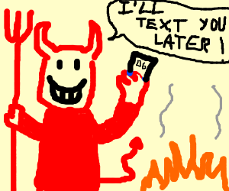
‘The devil’s got your number’

Slide 4
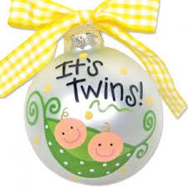
‘Mouths to feed. You’re expecting twins’

Slide 5
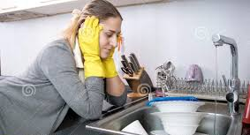
‘There’s a girl inside the woman, she’s waiting to break free’

Slide 6
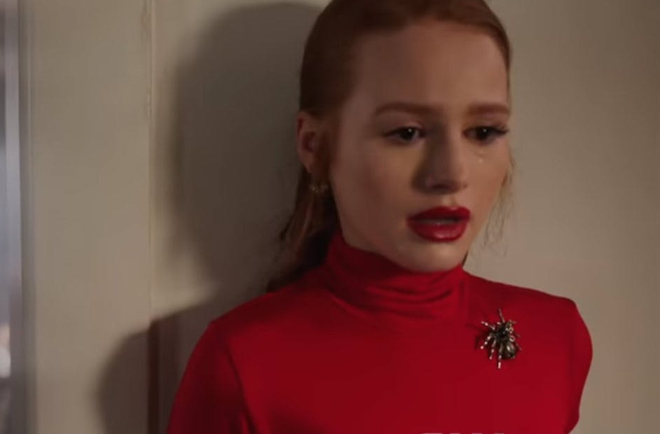
‘It’s just a secret, everybody has secrets, don’t you have secrets?’

Slide 7

‘Take no notice, Mickey. I love you.’

Slide 8
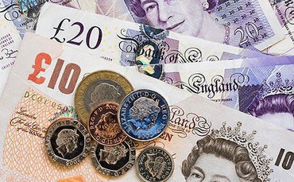
‘Look…come on…I’ve got money, plenty of it.’

Slide 9
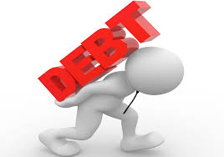
‘But a debt is a debt and must be paid.’

Slide 10

‘The mother, so cruel there’s a stone in place of her heart’

Slide 11

‘mam’
‘mummy’

Slide 12
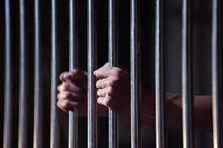
‘he was about to commit a serious crime’ ‘it was more of a prank really’

Slide 13
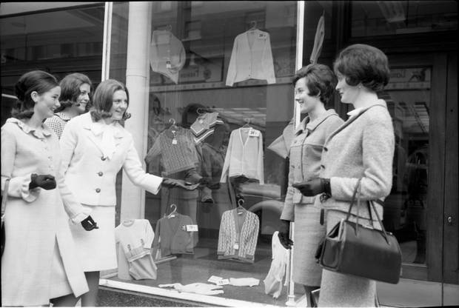
‘The house is your domain…I really must dash’

Slide 14
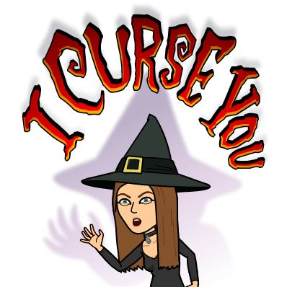
‘I curse you! Witch!’

Slide 15
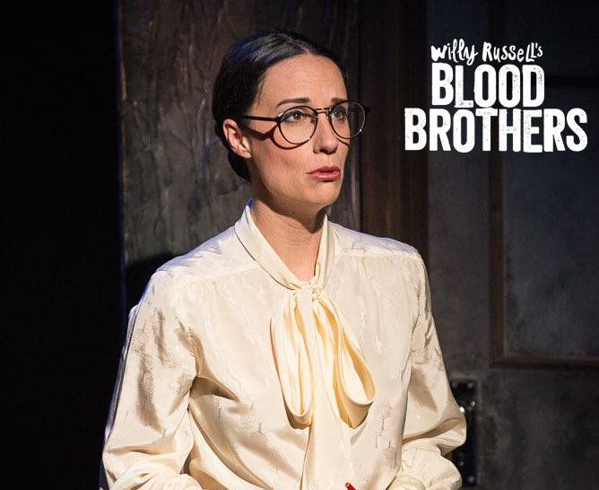
‘It’s a sign of the times, Miss Jones’

Slide 16
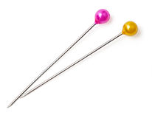
‘Did you ever hear the story of the Johnstone twins, as like each other as two new pins’

Slide 17

‘How come you got everything…an’ I got nothin’?’

